Slide 1
Solar Power Management System
ITP_WD_B08_G12

Slide 2
Content
Background
Problem and Motivation
Aim and Objectives
Methodology
System Overview
System Features
Individual Contribution

Slide 3
Background
B Tech Solar Solutions Pvt Ltd is a newly opened electrical contracting company situated in Kottawa, Sri Lanka
The company currently offer affordable solar installation options for commercial and residential properties, providing you with the latest technology and financial incentives.
currently, the company runs a manual system where all the employees collaborate with physical data transfer techniques and databases.
From the proposed system we intend to develop the client’s desires to Increase performance and manage all the operations in the company efficiently.

Slide 4
Problem and Motivation
An inconsistent data-entering process
Low security
Manual Record Keeping and poor record storing facilities.
Harder to obtain SRI LANKA SUSTAINABLE ENERGY Authority clearance (SLSEA)

Slide 5
Aim and Objectives
Responsive web application
Automated database records
Simple user-friendly interface
Access from anywhere anytime

Slide 6



Methodology
Database – MongoDB
Backend – Express, NodeJS
Frontend – React
IDE – Visual Studio Code
Testing – Postman

Slide 7
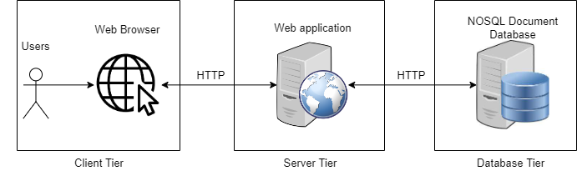
SYSTEM OVERVIEW
Employee Management
Repair Management
Inventory Management
Customer Management
Finance Management
Project Management
Transport Management
Promotions & Offers Management

Slide 8

SYSTEM FEATURES

Slide 9
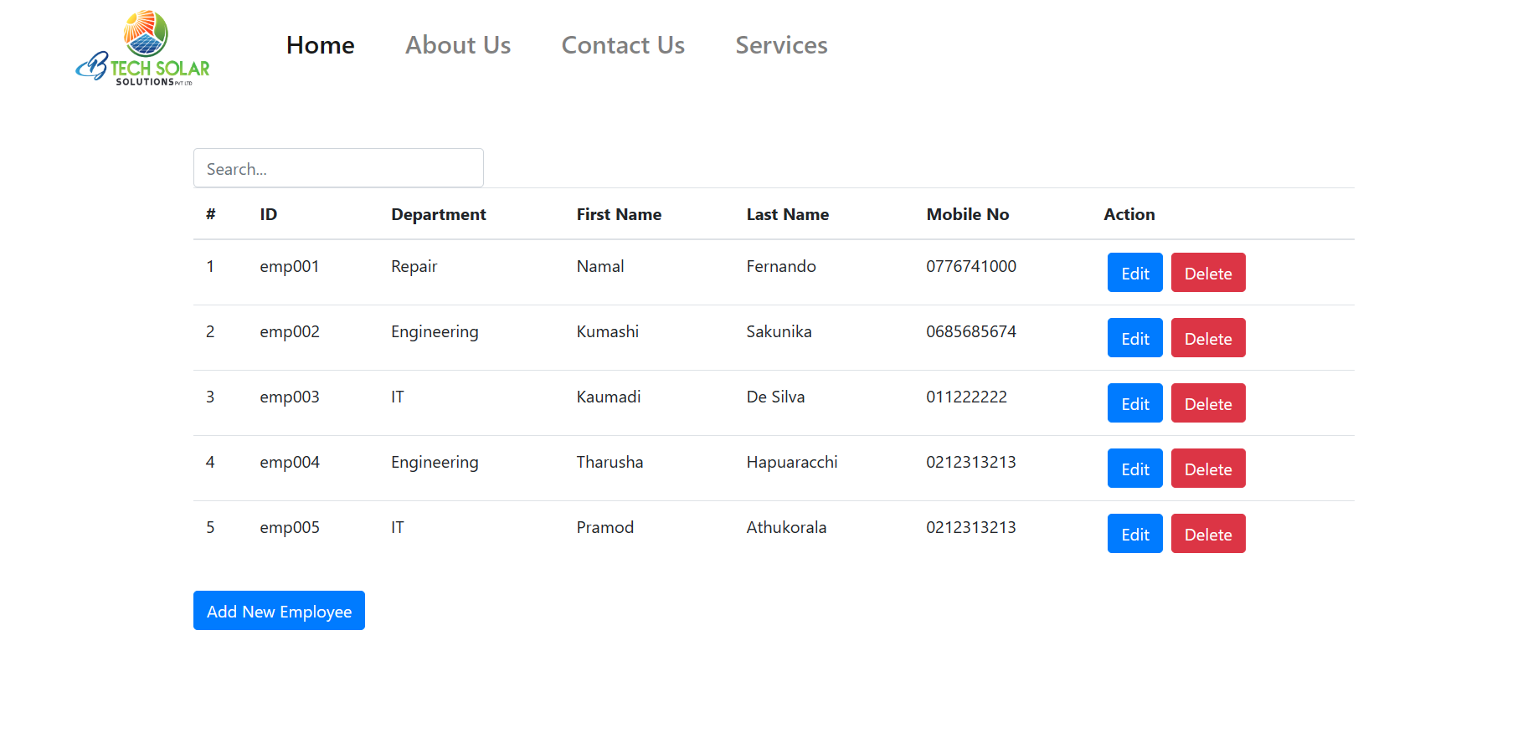
1. Employee Management (Complete)

Slide 10
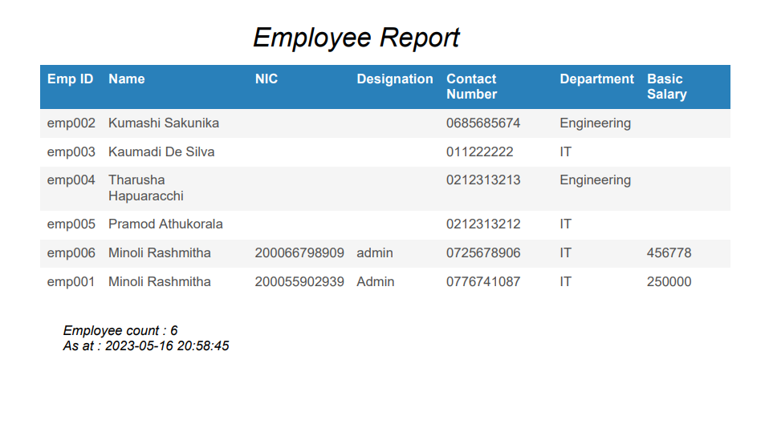

Slide 11
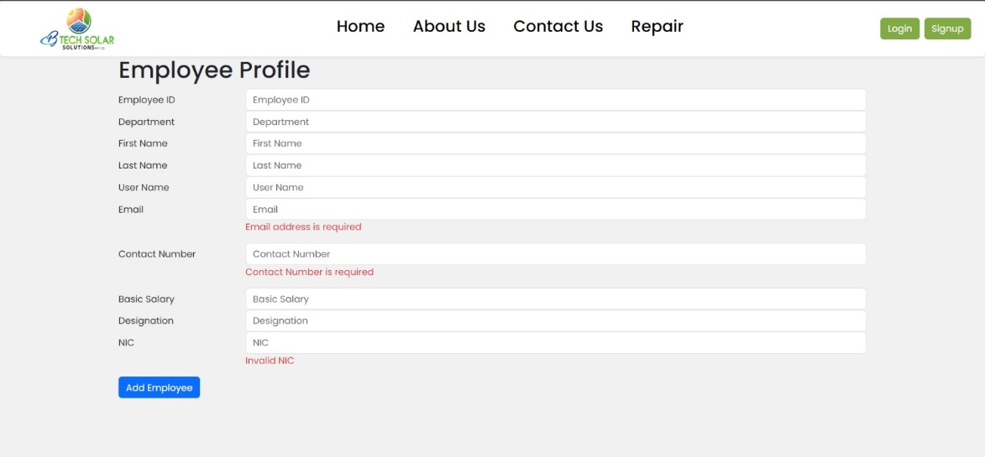
1. Employee Management (Complete)
When Employee Manager enter Employee ID in the search bar relevant search results are displayed.
When delete button is clicked the Employee details will be deleted.
When Edit button is clicked the relevant details can be edited and updated.
All the features are COMPLETED

Slide 12
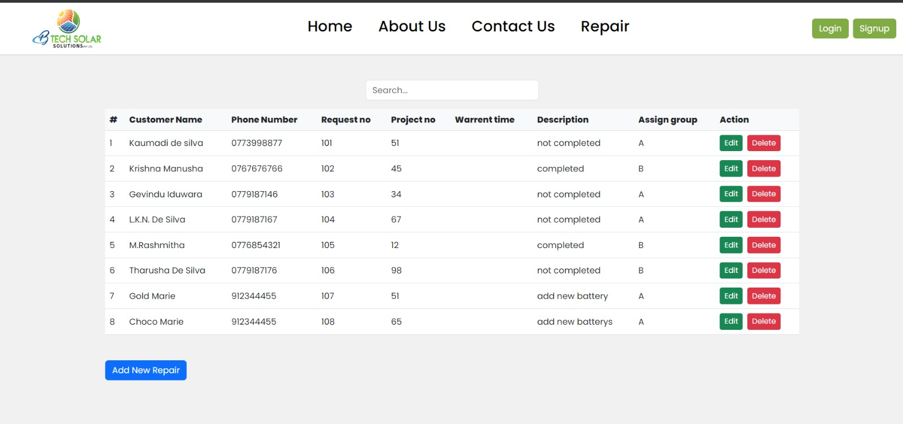
2. Repair Management (Complete)

Slide 13
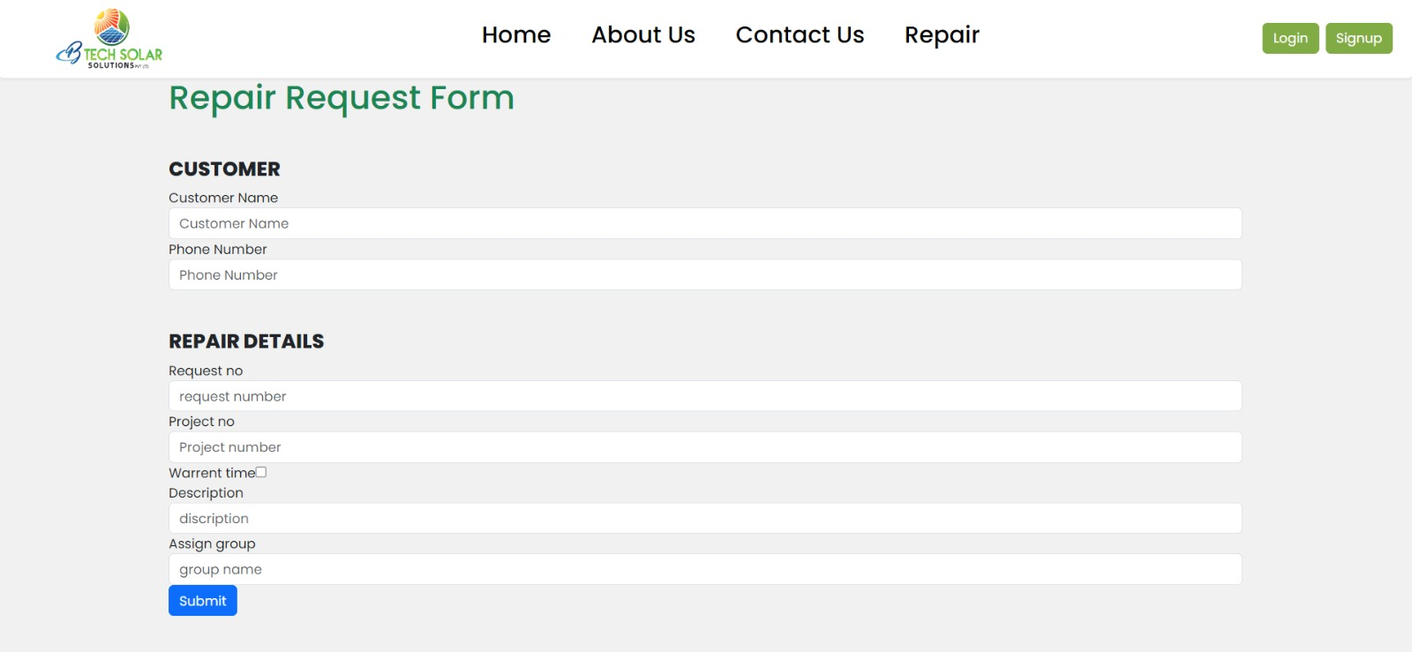

Slide 14
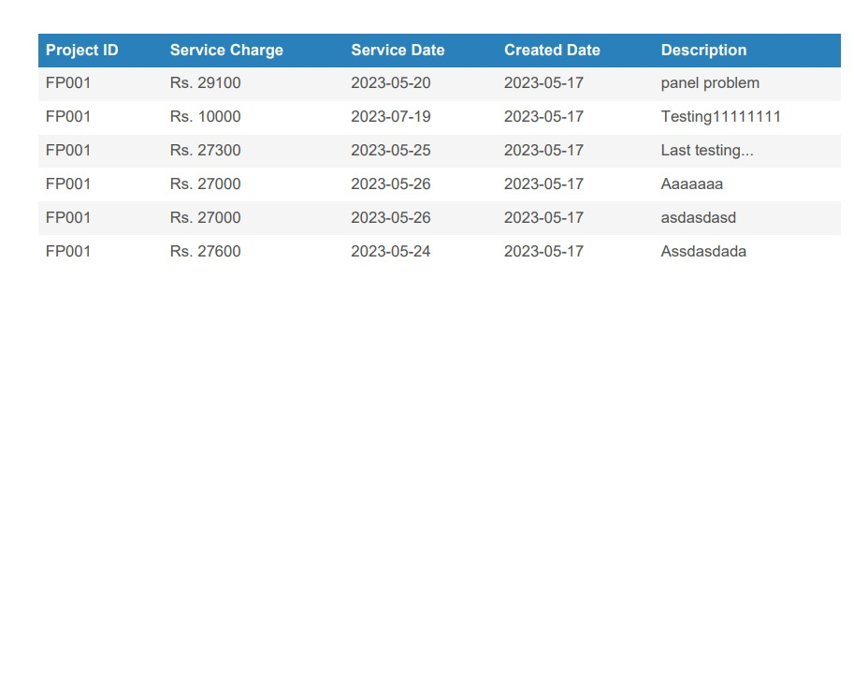

Slide 15
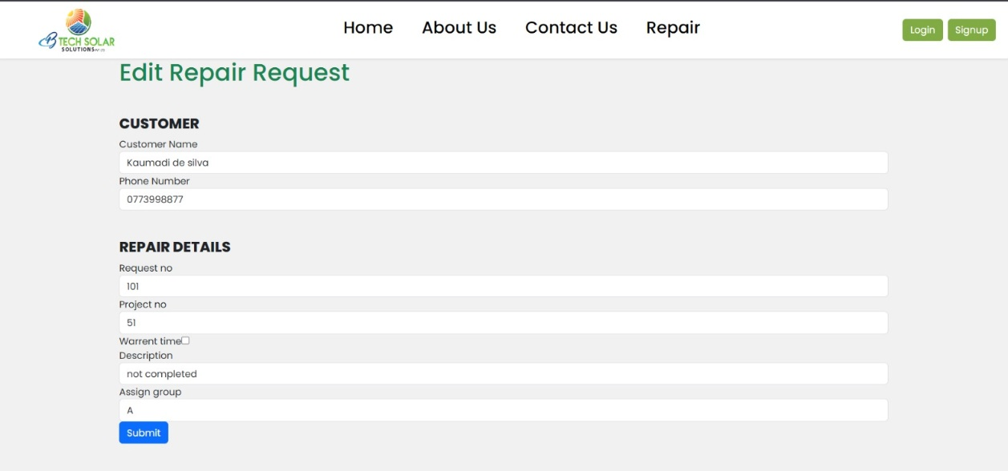
All the features are COMPLETED

Slide 16
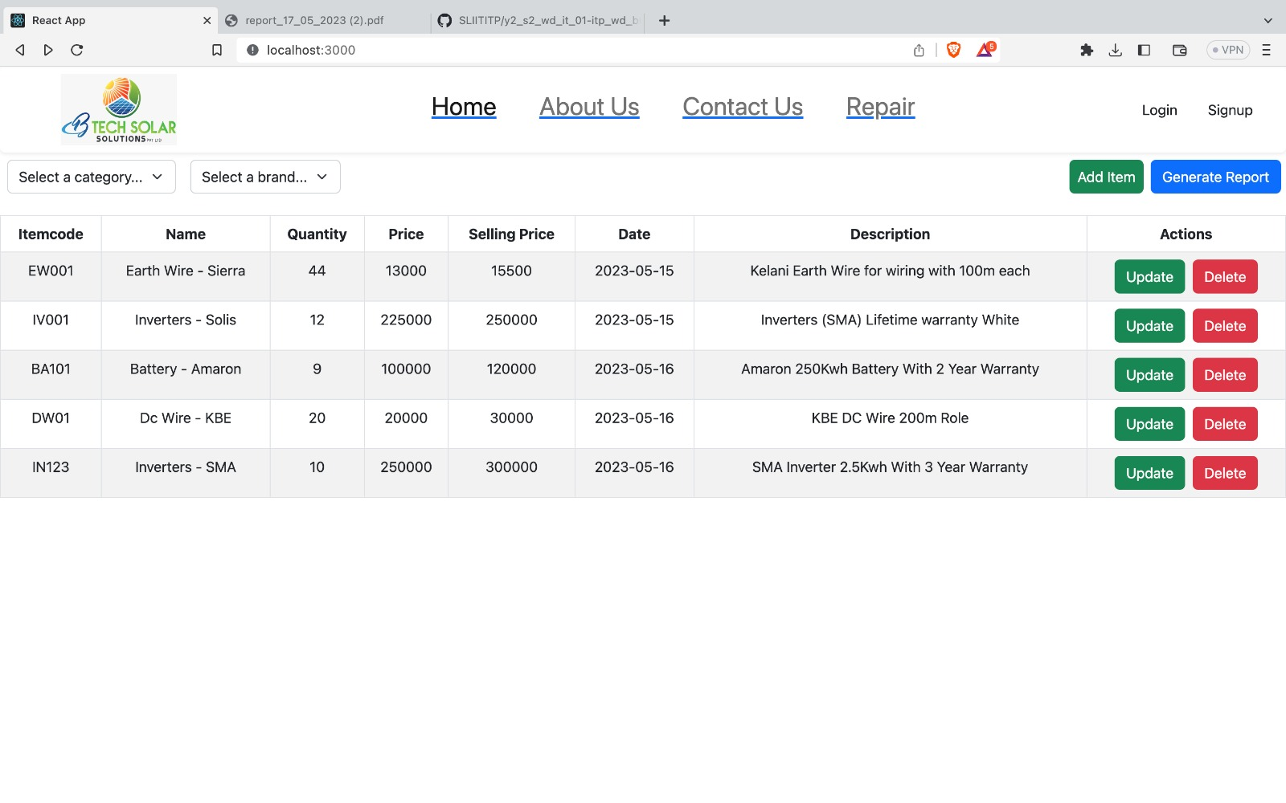
3. Inventory Management (Complete)

Slide 17
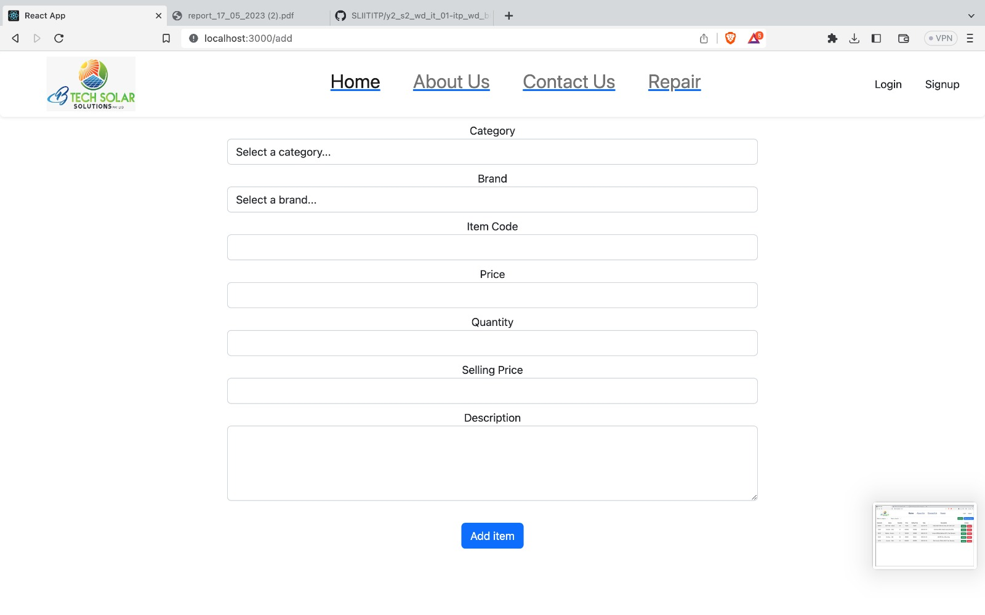

Slide 18
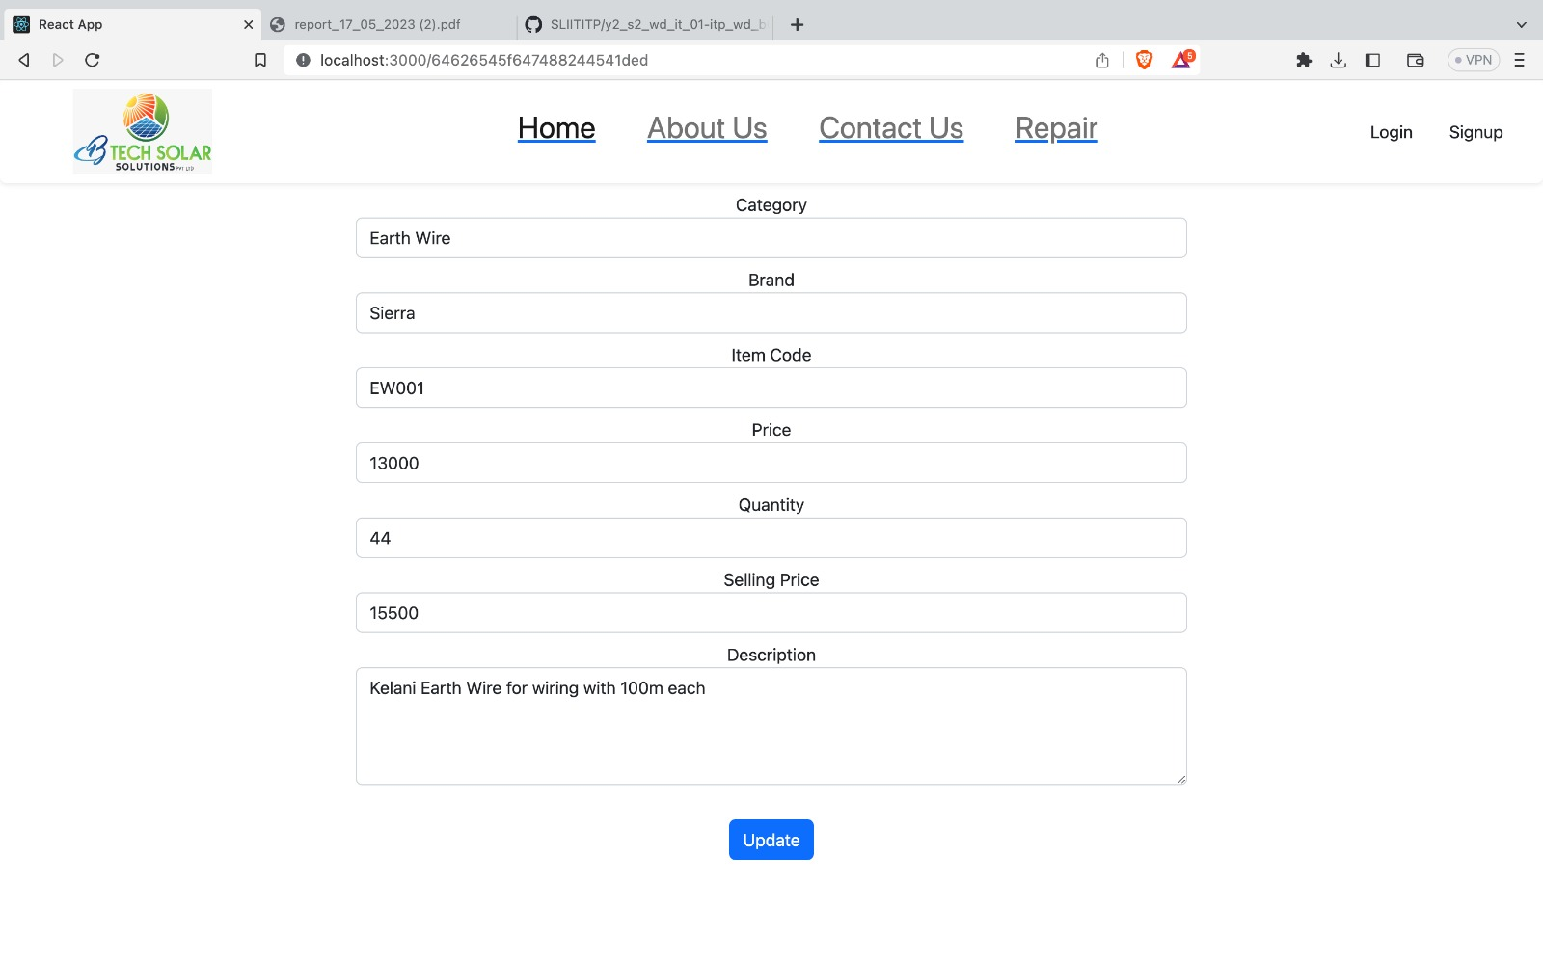

Slide 19
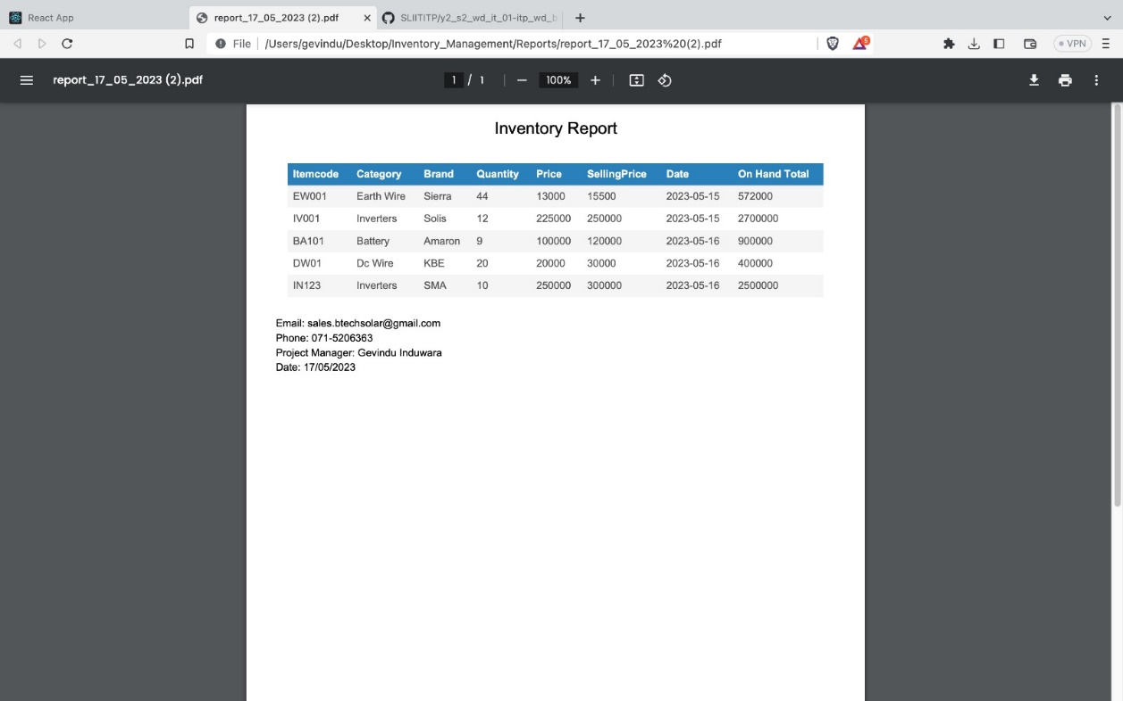
All the features are COMPLETED

Slide 20
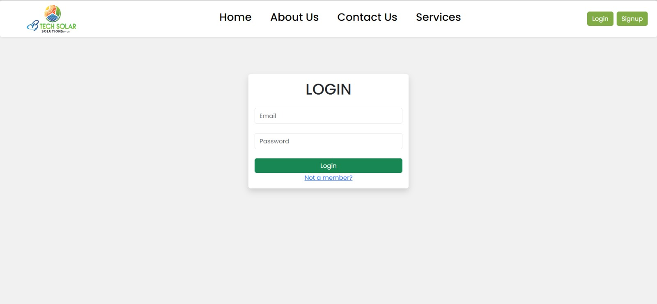
4. Customer Management (Complete)

Slide 21
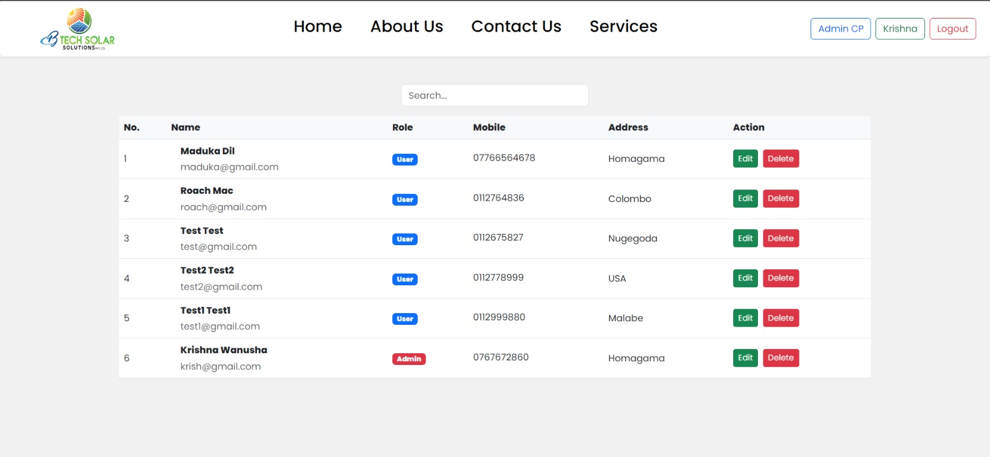

Slide 22
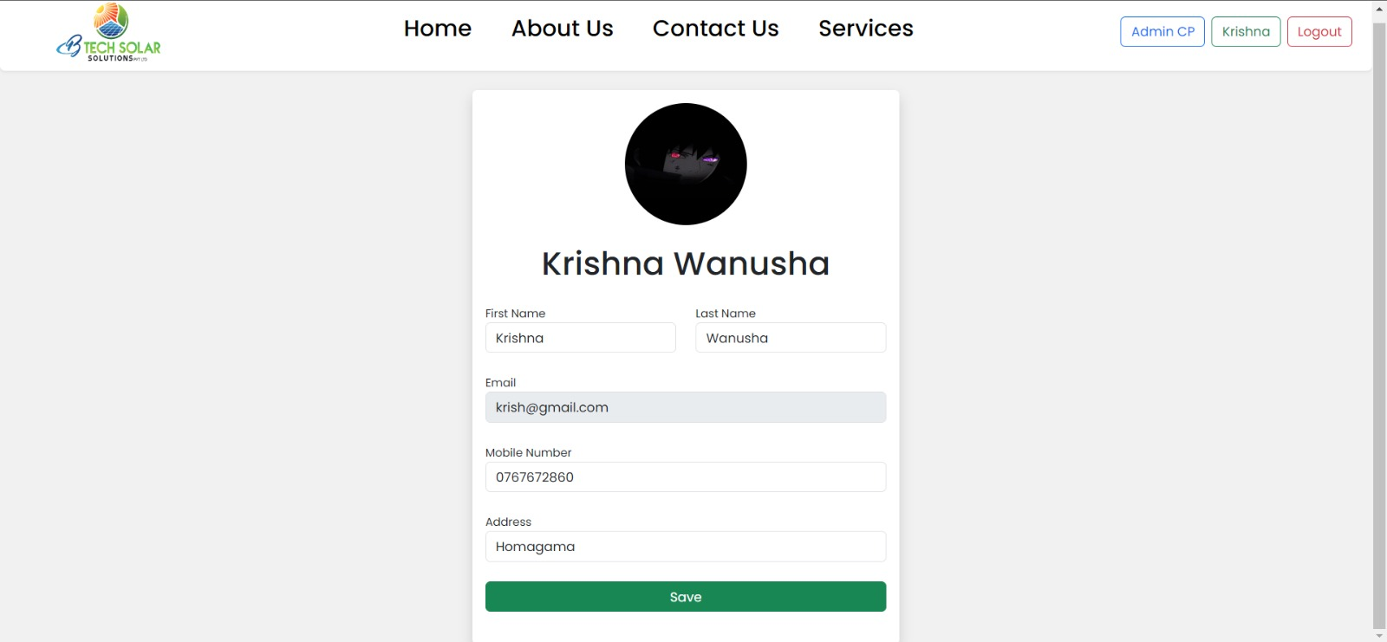

Slide 24
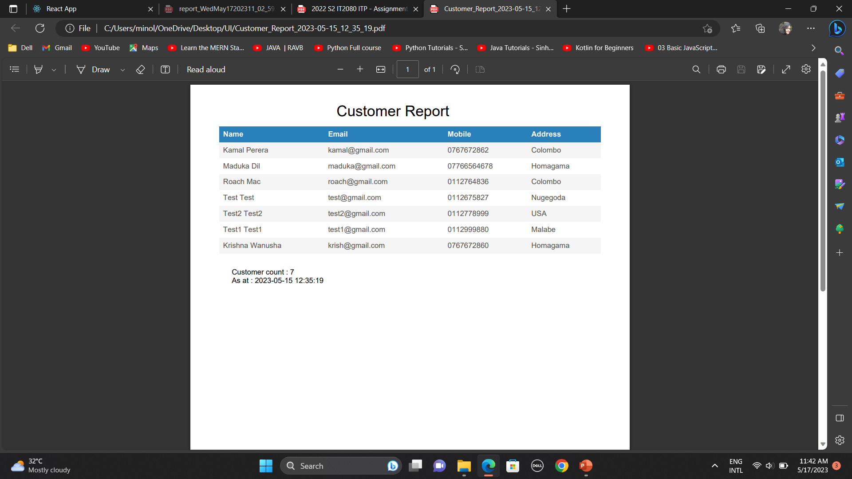

Slide 25
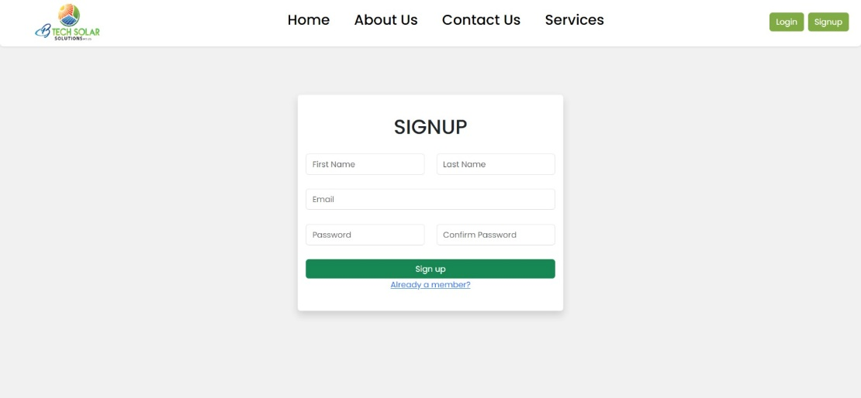
All the features are completed

Slide 26
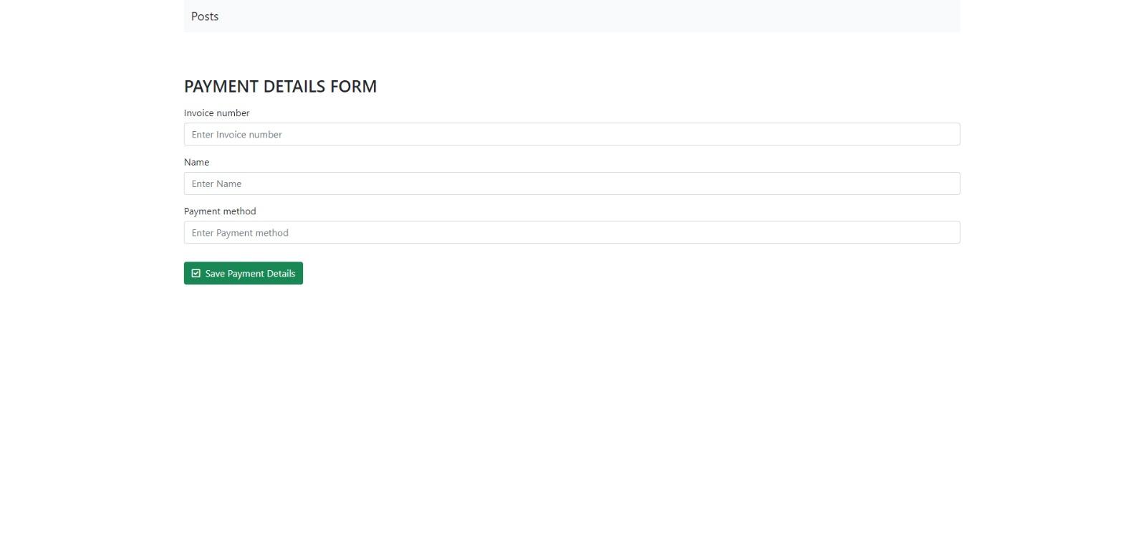
5. Finance Management (Complete)

Slide 27
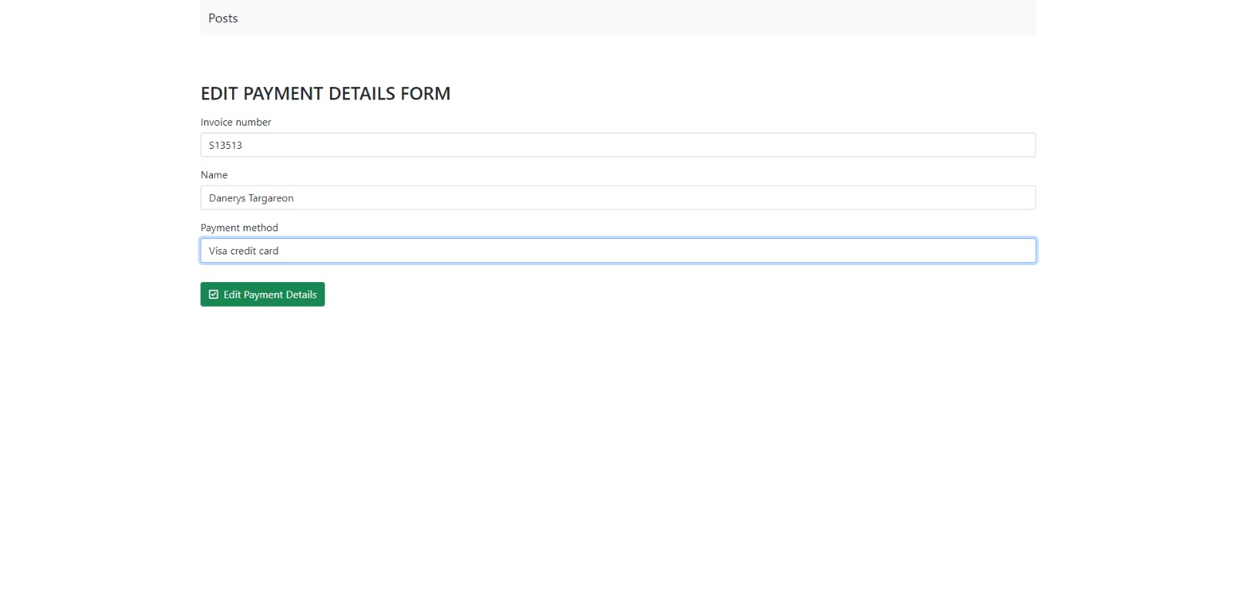

Slide 28
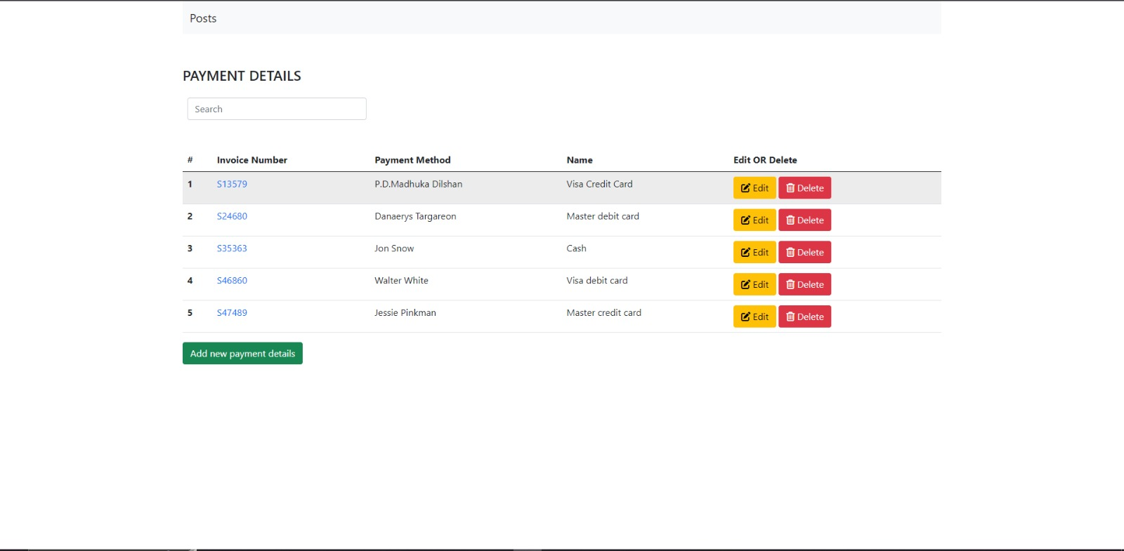

Slide 29
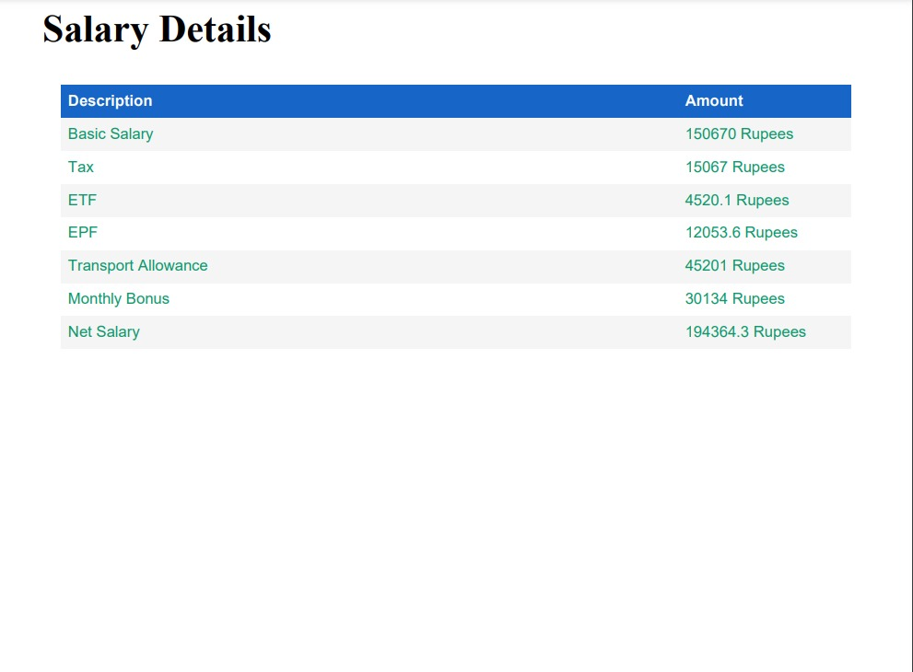

Slide 30
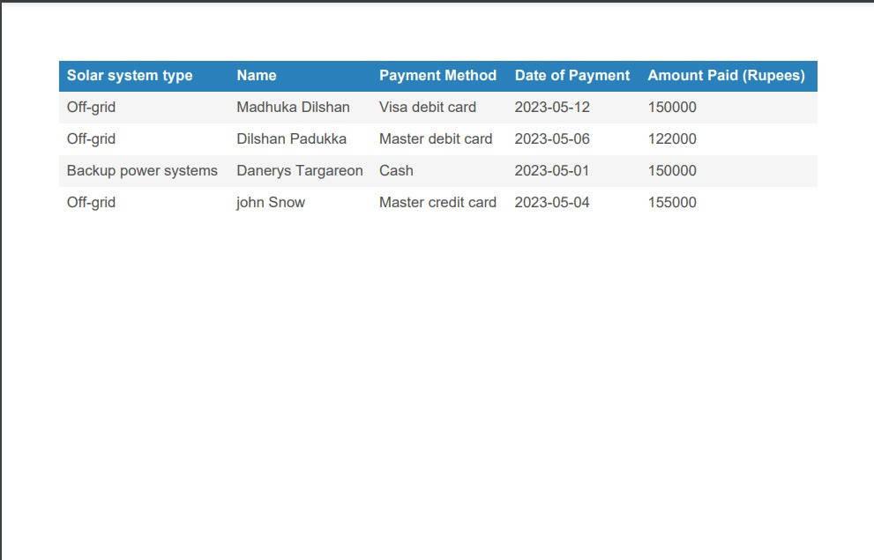
All the features are COMPLETED

Slide 31
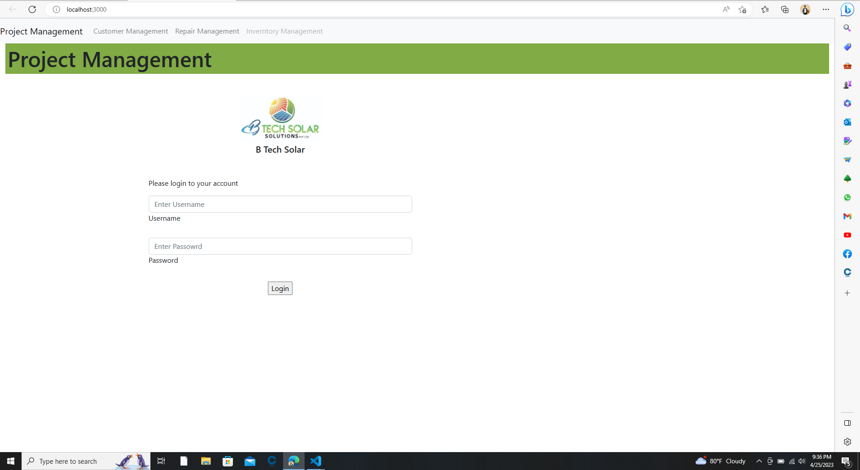
6. Project Management (Complete)

Slide 32
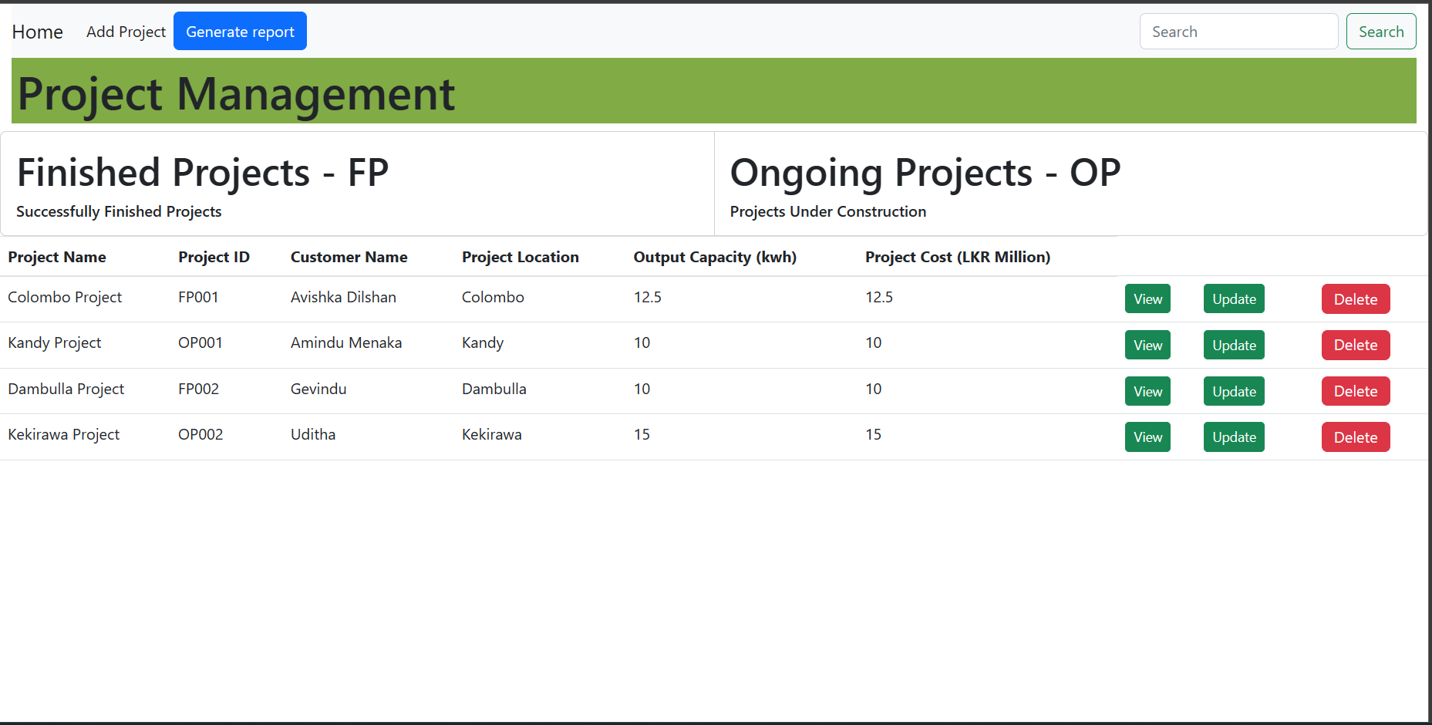

Slide 33
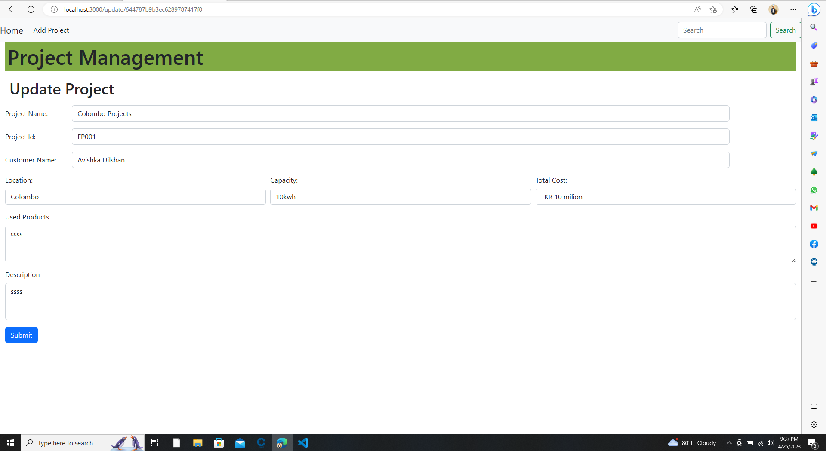

Slide 34
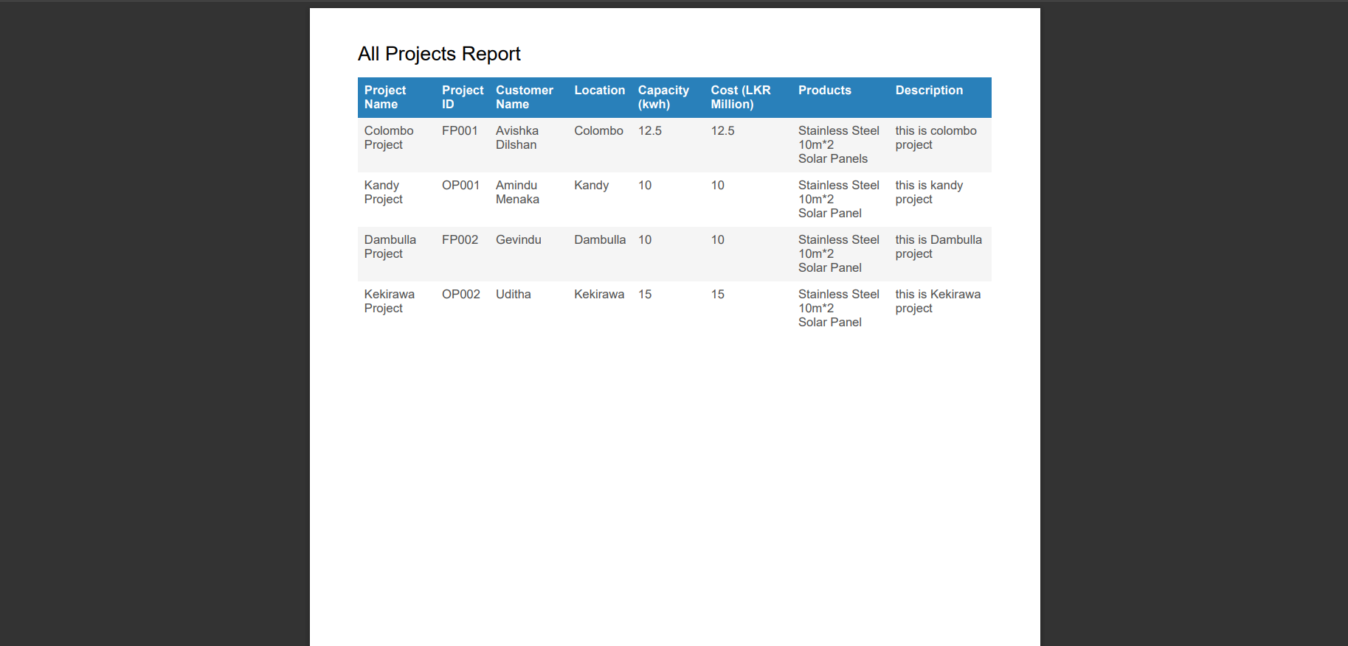

Slide 35
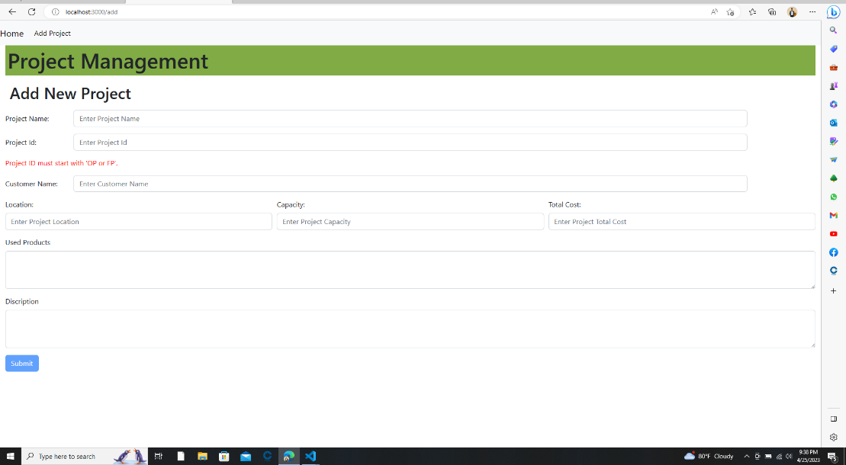
All the features are completed

Slide 36
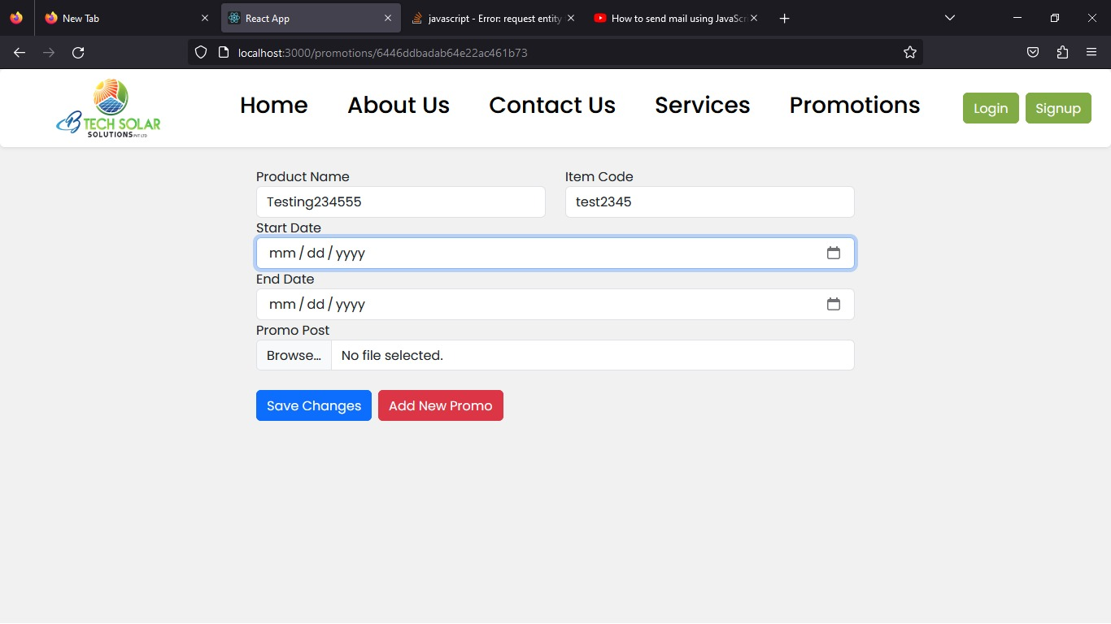
7. Promotions Management (Complete)

Slide 37
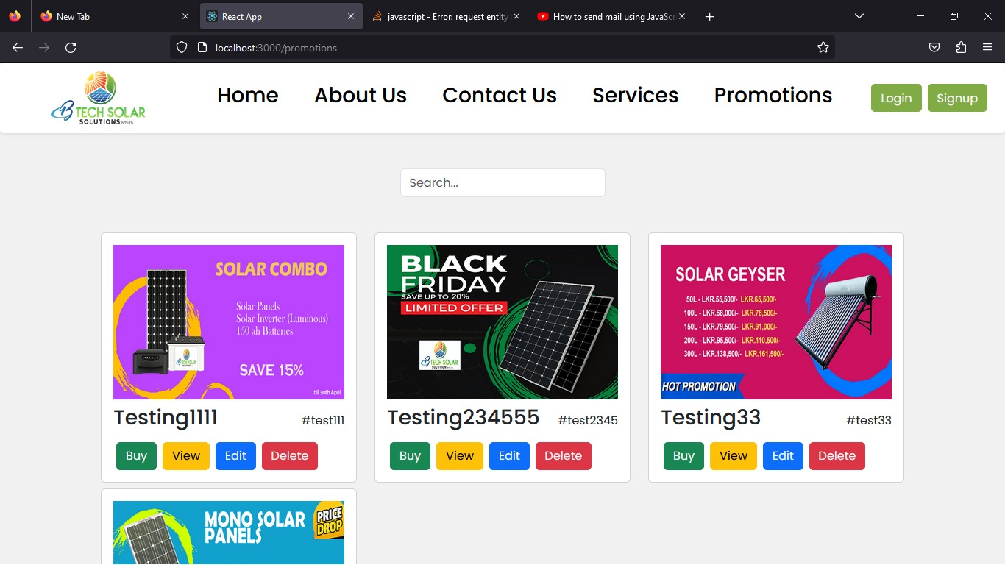

Slide 38
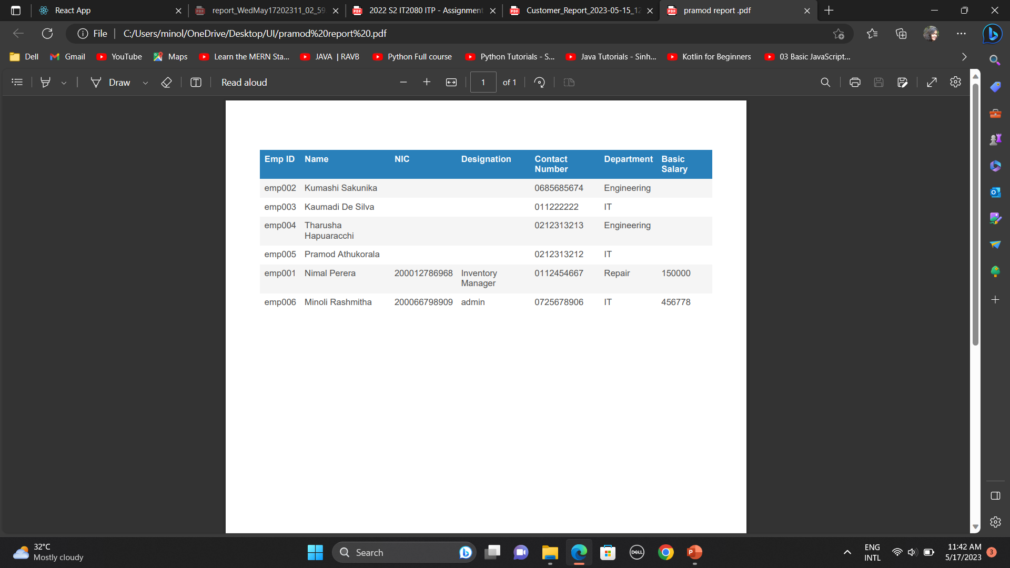

Slide 39
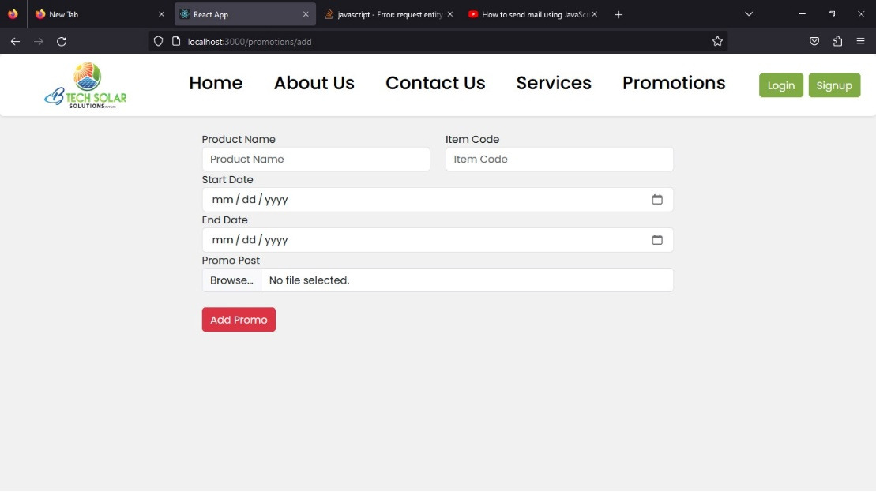
All the features are completed

Slide 40
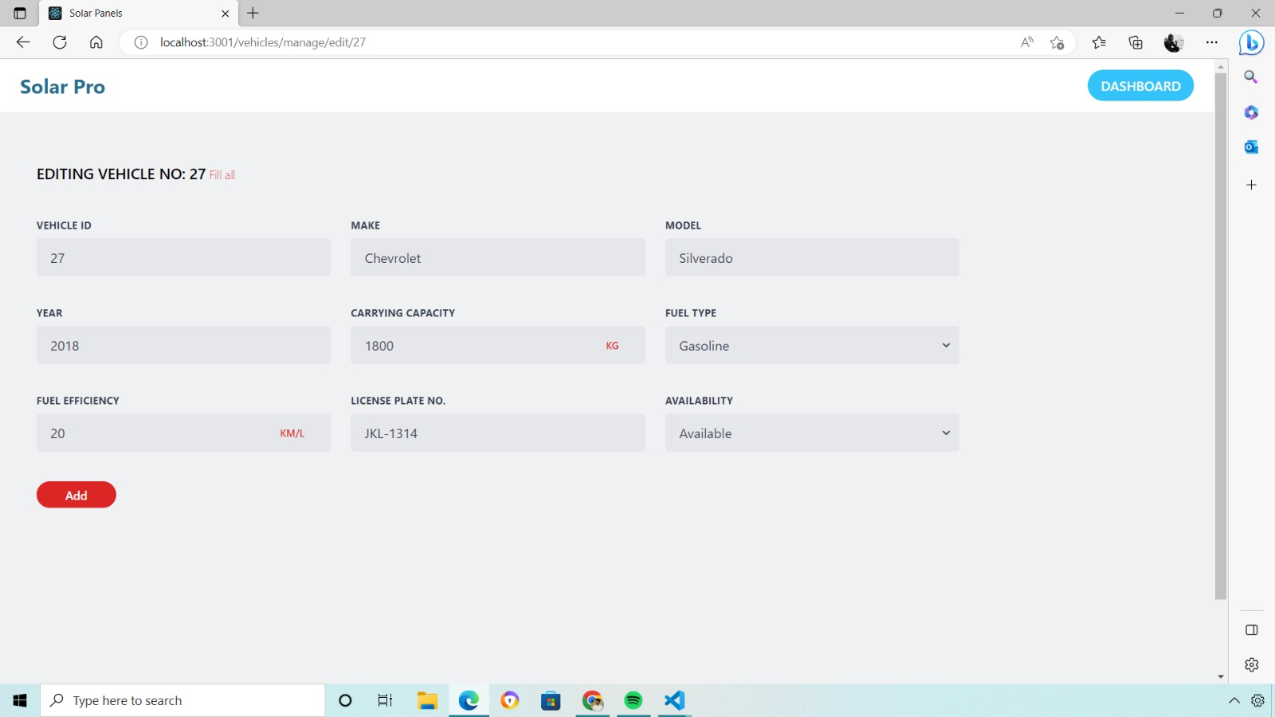
8. Transport Management (Complete)

Slide 41
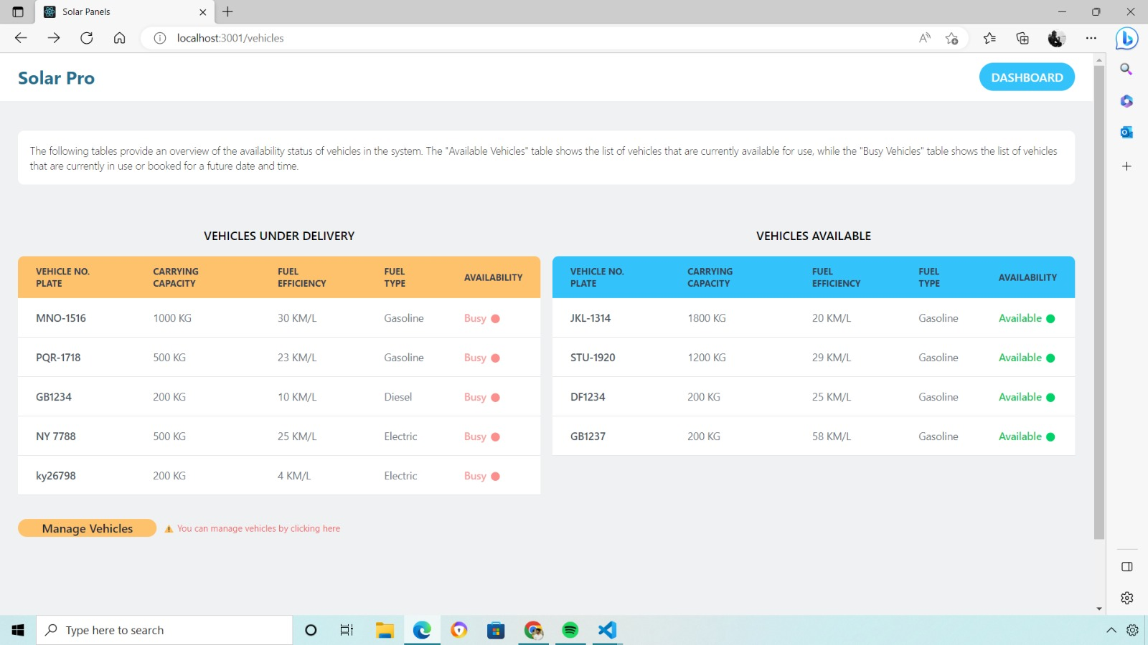

Slide 42
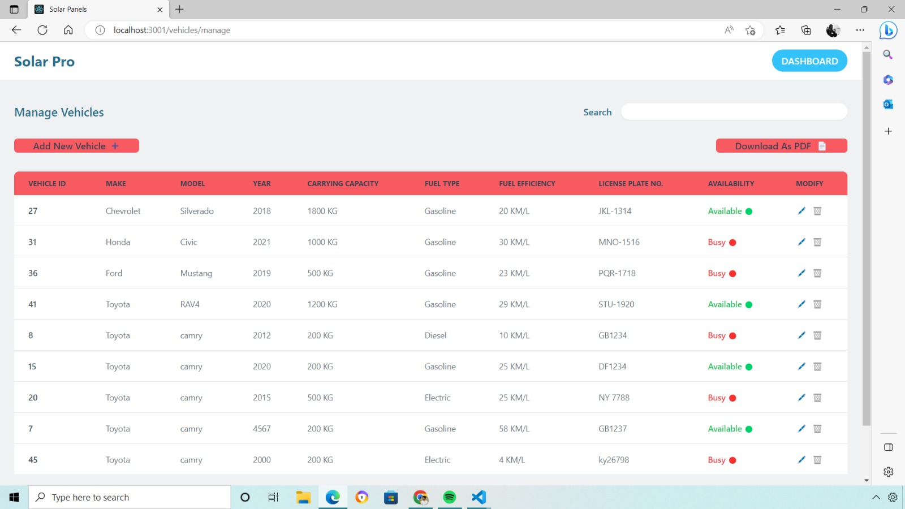

Slide 43
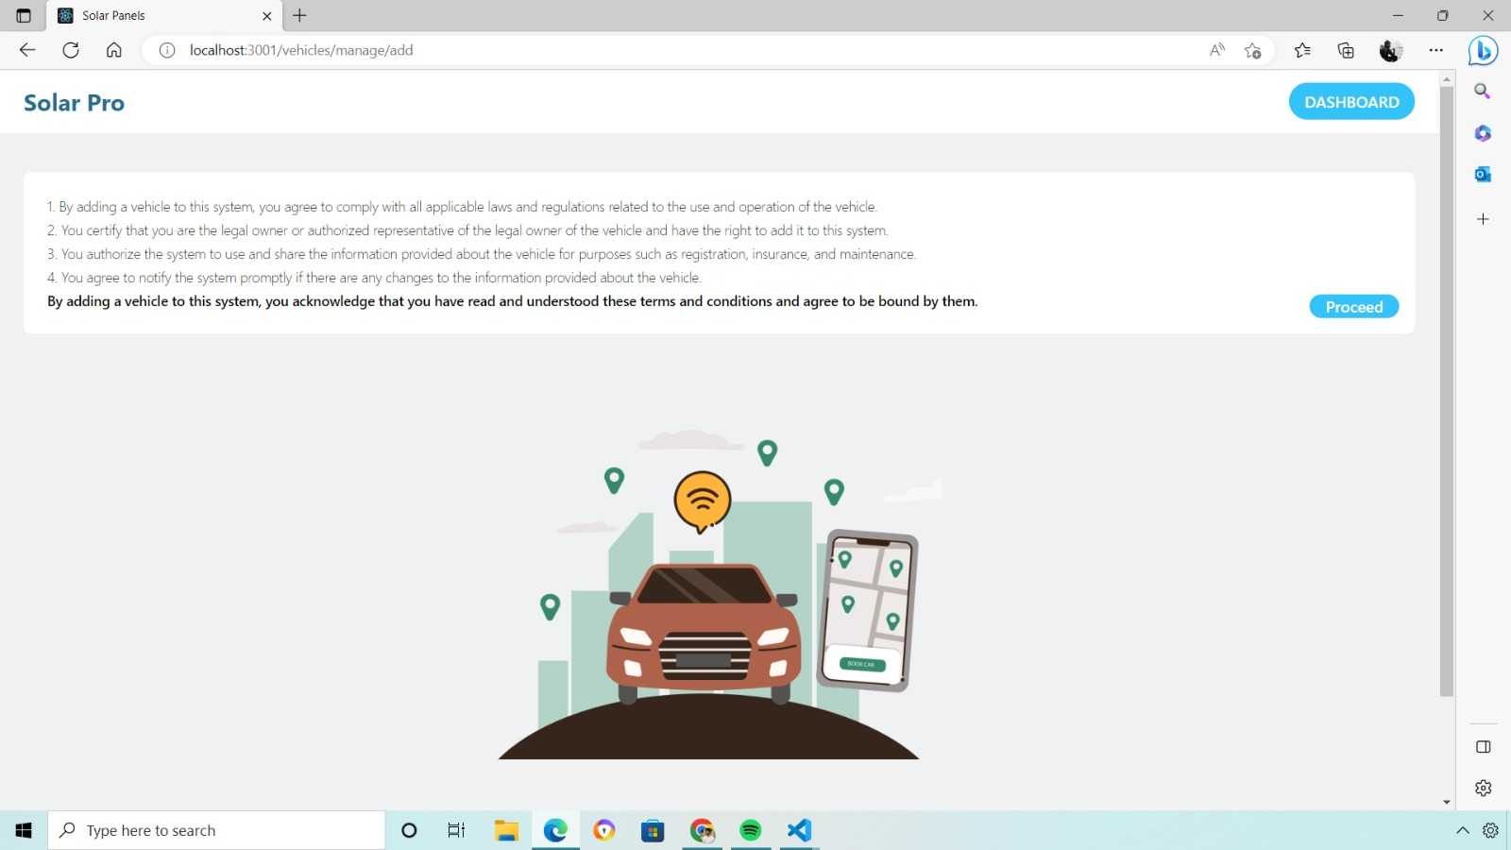

Slide 44
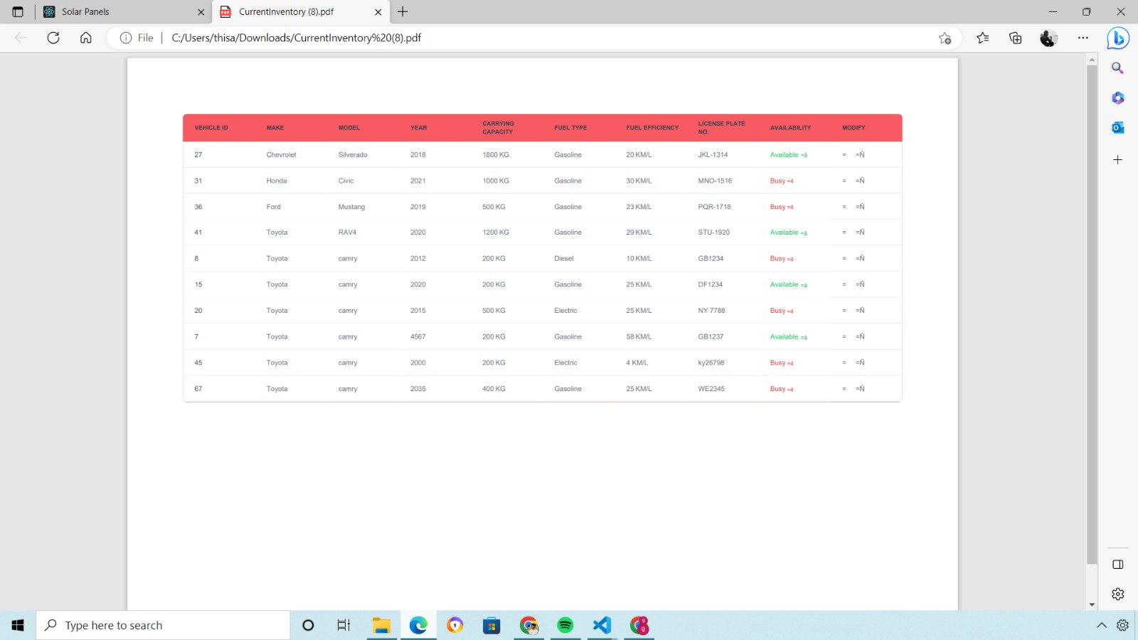

Slide 45
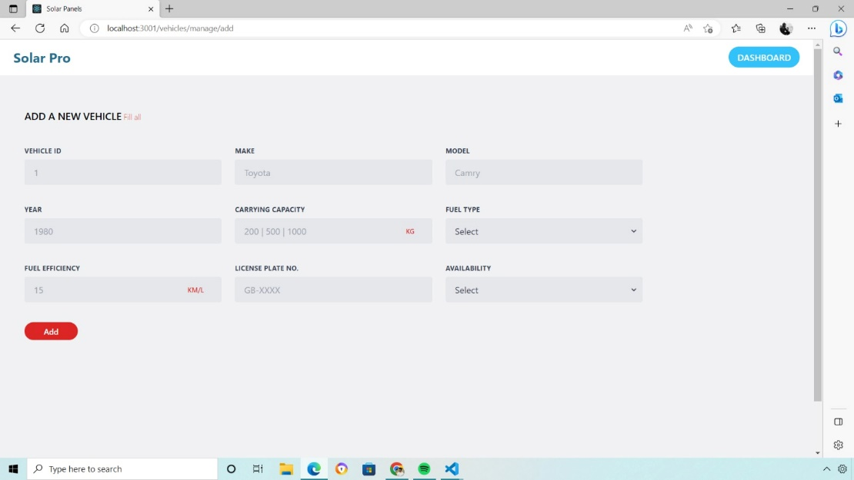
All the features are COMPLETED

Slide 46
Student ID | Name with initial | Work allocated
IT21284120 | Rashmitha K.M | Employee Management
IT21283062 | De Silva L.K.N | Repair Management
IT21255410 | Malwaththa M.A.G.I | Inventory Management
IT21277436 | Jayasinghe K.W | Customer Management
IT21277504 | Padukka P.D.M.D. | Finance Management
IT21283994 | Athukorala P.D. | Promotions Management
IT21281846 | Hapuarachchi T.L. | Project Management
IT21267536 | Waduge T.R. | Transport Management

Slide 47
THANK YOU

